Slide 1

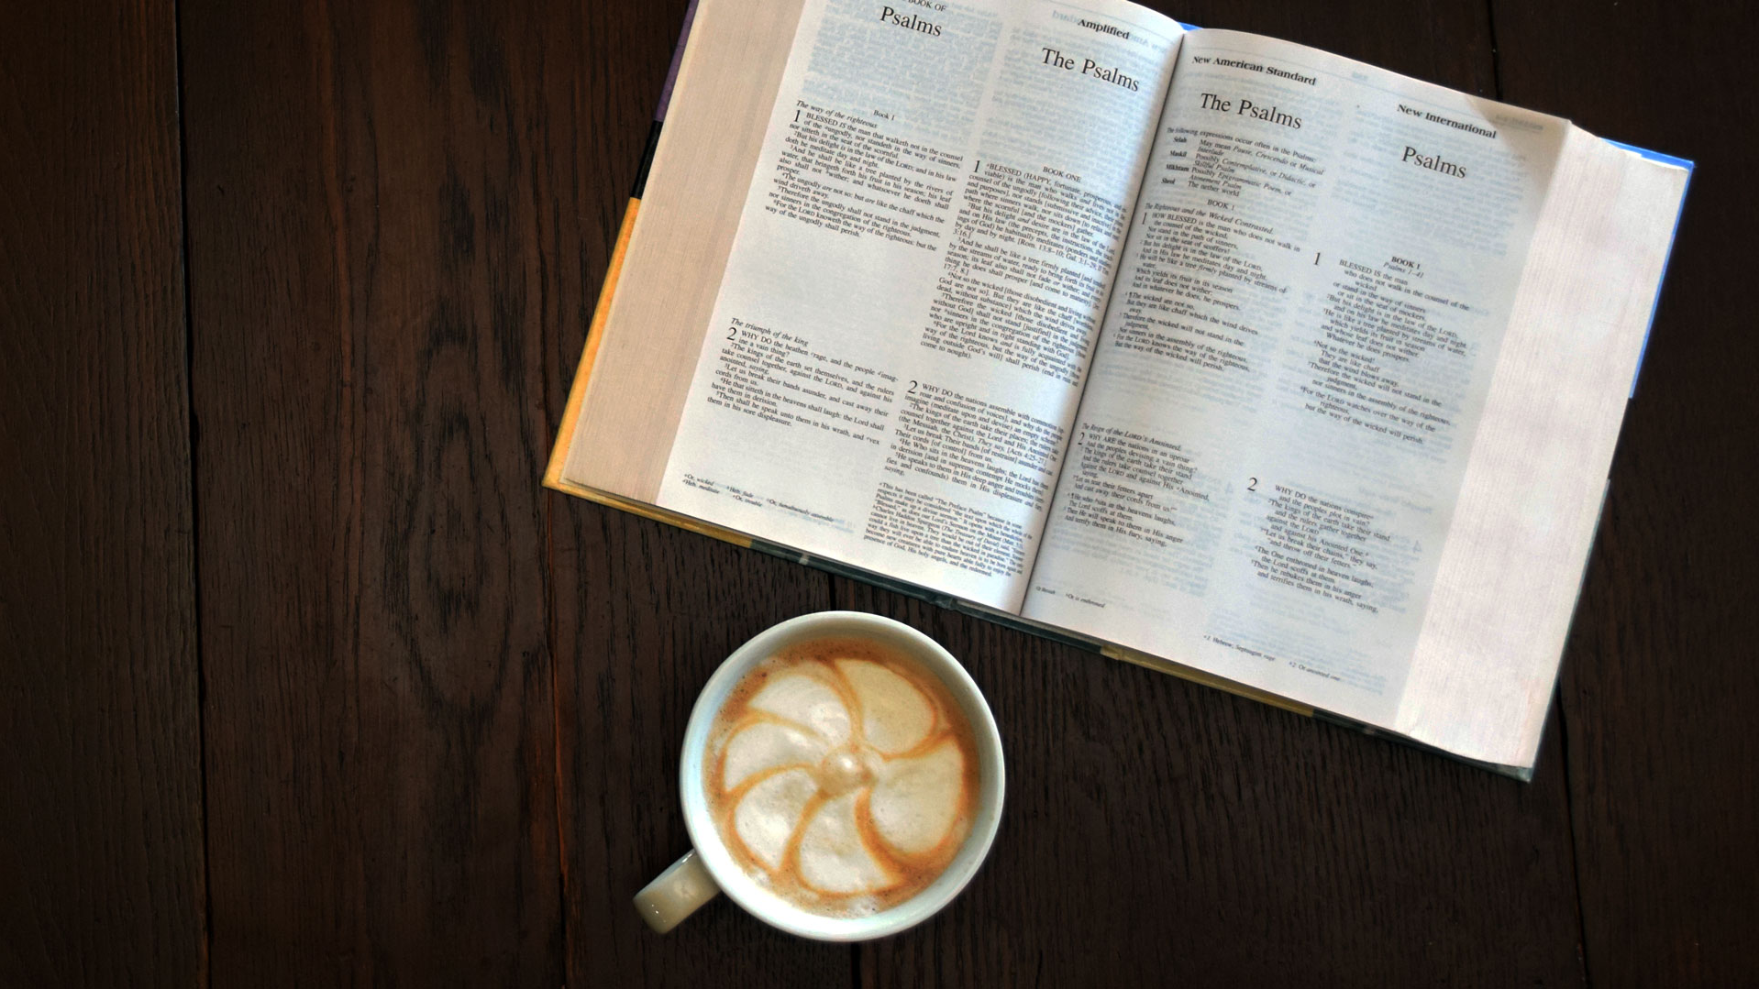
Lesson 11
^{1st Peter}
^{4:1-6}
Who‘s
Will?

Slide 2
1 Peter 4:1 (ICB)
¹Christ suffered while he was in his body. So you should strengthen yourselves with the same way of thinking Christ had. The person who has suffered in his body is finished with sin.

Slide 3
1 Peter 4:2-3 (ICB)
²Strengthen yourselves so that you will live your lives here on earth doing what God wants, not doing the evil things that people want. ³In the past you wasted too much time doing what the non-believers like to do. You lived for the body and evil desires. You were getting drunk, you had wild and drunken parties, and you did wrong by worshiping idols.

Slide 4
1 Peter 4:4-5 (ICB)
⁴Non-believers think it is strange that you do not do the many wild and wasteful things that they do. And so they insult you. ⁵But they will have to explain about what they have done. They must explain to God who is ready to judge the living and the dead.

Slide 5
1 Peter 4:6 (ICB)
⁶The Good News was preached to those who are now dead. By their dying, they were judged like all men. But the Good News was preached to them so that they could live in the spirit as God lives.

Slide 6
REVIEW
Why do we need to strengthen ourselves?

Slide 7
REVIEW
Why do people think we are “Crazy Christians”?

Slide 8
REVIEW
Why do we need to be ready to explain our faith?

